Slide 1
Aid Escalating Coverage: - Project Report
Date: - 13th December 2022
Abhinav Mahajan, IMT2020553
Shaurya Agrawal, IMT2020539

Slide 2
1.) Pre-processing: -
Our first step was to perform EDA (Exploratory Data Analysis). In specific, the categorical (discrete, one hot encodable data) and non categorical features.
All the ? And unknown values were changed to np.NaN.
alchemy_category, alchemy_category_score, is_news_ news_front_page had null values and the non categorical data columns had their null values replaced by their mean.
alchemy_category was one hot encoded as it had various discrete types.
A bar plot is used to see correlation between a feature and the class label as a preliminary analysis of feature importance. More robust feature engineering performed later.

Slide 3
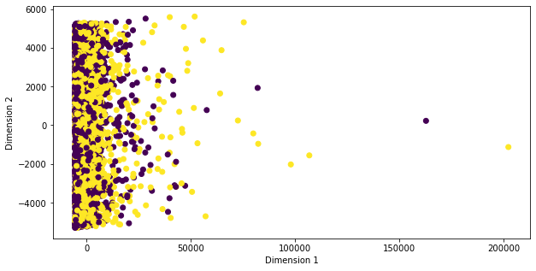
2.) Feature Engineering: -
I will be following the post : - https://towardsdatascience.com/feature-selection-techniques-for-classification-and-python-tips-for-their-application-10c0ddd7918b
Unsupervised Technique (PCA)
We can see, PCA is unable to segregate the class labels into a more linearly separable space, therefore, more techniques are carried out.

Slide 4
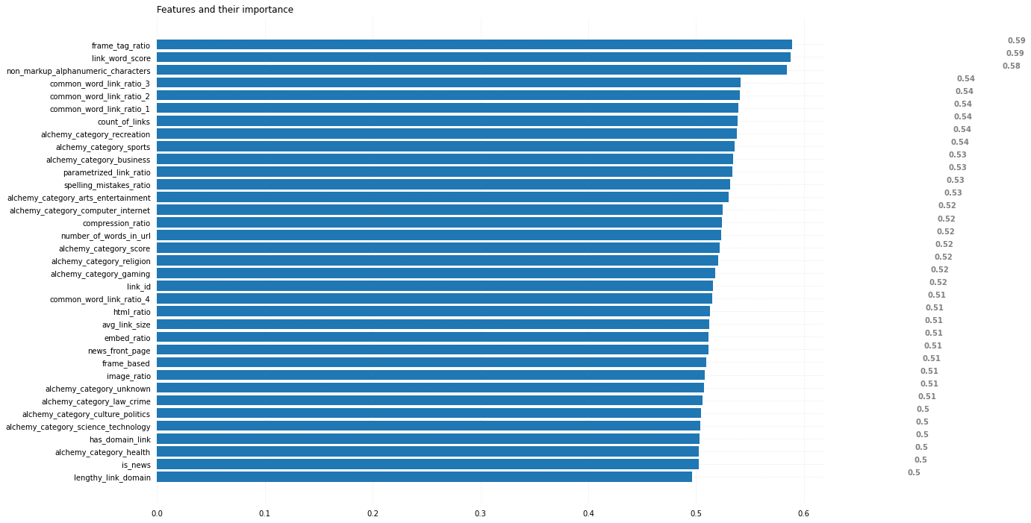
2.) Univariate Filtering techniques
I have fit a LR, to each feature to see their importance. This technique is used to find features, if any, that stand out and have high independent correlation with the label.

Slide 5
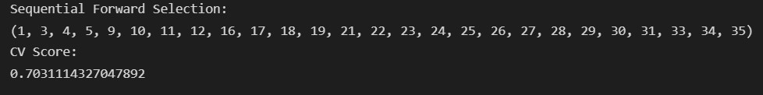
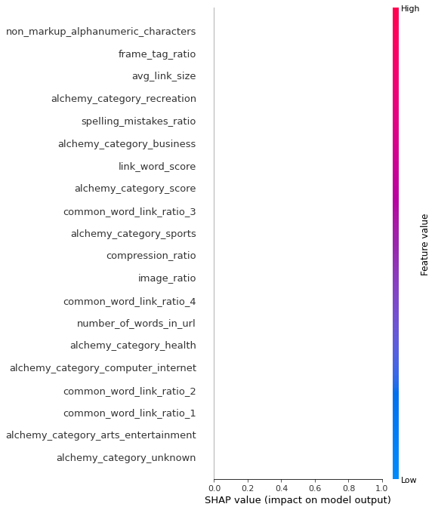
3.) Wrapper Technique (Most accurate, Computationally expensive)
In this technique, I have used the 3rd party library mlxtend to perform exhaustive and sequential forward and backward searching of the optimal parameters with the optimal model.
The output corresponds to the index numbers of the features with a LR solver. This is the output of Sequential Forward search. Backward Search and searching with Float flag did not converge, and exhaustive search takes too long.
4.) Tree based models (Using XGBoost, to overcome the computational problems of 3)
The only reason for using the answer from step 3 over 4 is because this method of feature importance heavily penalises features with high correlation, therefore even if any features are important and together have high correlation with the class label, this model will report a low feature importance.

Slide 6
3.) NLP + Preliminary Model Ensemble
The textual features, “page_description” is preprocessed by extracting their components, and then removing all extra spaces, converting everything to lowercase, removing stop words, single letter words, removing numbers and finally lemmatization. Using urlparse, the same procedure is done for “link” feature.
TF-IDF is used, as discussed last time, over bag of words.
Now, we introduce columns in the training and testing data frames that have completely preprocessed textual data. “text_title” holds the title component of page_description, “text_url” holds the url component of page_description, “text_body” holds the body, “parsed_link” contains the preprocessed link data, “Complete_Textual_Data” contains the concatenation of the previously mentioned 4 columns and “parsed_page_description” contains the concatenation of the parsed page_description strings.
Model 1 (Public roc_score of 0.876): - ‘text_title’, ‘text_url’ and ‘text_body’ are sent through a pipeline with a TF-IDF Transformer, which is column transformed by a Logistic Regressor.
Model 2 (Public roc_score of 0.876): - 1 letter words and non-vocabulary words (from nltk) were removed and then the same process as Model 1 was done. This lead to a decrease in performance, therefore, the latter pre-processing technique was scrapped(commented out)

Slide 7
Model 3 (Public roc_score of 0.875): - Now to our Model 1 pipeline, we add another of ‘parsed_link’(after parsing the url) feature. The score is not too affected, but this is mostly due to the architecture of the model. Later on we will see that ‘parsed_url’ is a significant feature.
Model 4 (Best Preliminary Model, Public roc_score of 0.882): - Now we feed in ‘Complete_Textual_Data’ feature to a TF-IDF transformer and apply a LR to it. Also, an important change made was to make the vocabulary from the entire corpus of text data (training and test)
Model 5 (Public roc_score of 0.867): - Now we decide to integrate all our important features. ‘Complete_Textual_Data’ is fed through a TF-IDF Pipeline, Non-Categorical Data is fed through a StandardSclaer() and SimpleImputer(). Categorical Features are fed to a one-hot-encoder and The Column Transformer Applied is Logistic Regression. The inferences from this model is seen later.
Model 6 (Public roc_score of 0.880): - Textual Data and Non-Textual Data separated. Hybrid of Model 3 (Textual Data) + Model 5 (For Non-Textual Data). Each Pipeline is connected to a Logistic Regressor, which is in turn connected to one integrating Regressor.
Model 7 (Public roc_score of 0.874): - Approach based of a paper by Stanford University. Each Textual Feature (‘text_url’, ‘text_title’, ‘text_body’, ‘parsed_link’) after TF-IDF, fed to a LR, then connected to an integrating LR.
Model 8 (Public roc_score of 0.878): - Similar to Model 7, but now ‘parsed_link’ and ‘parsed_page_description’ are fed to the Model.

Slide 8
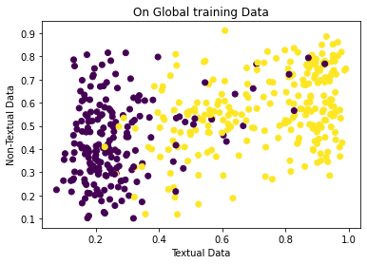
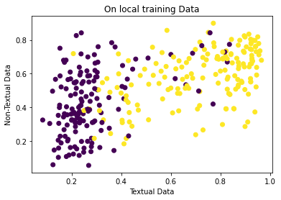
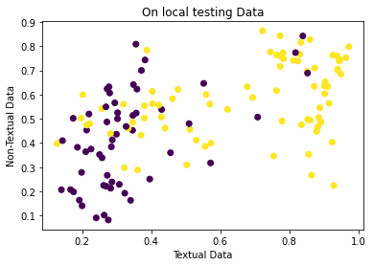
Takeaways: -
From these visualisations generated from the output of model 6, we can see the model intrinsically trains the data from the textual features with far more weightage than the non-textual features.
Therefore, from now we will only consider Textual Data and discard the non-textual features.
Fitting a TF-IDF vectorizer’s vocabulary of a feature gives more accuracy when vocabulary is fitted with train + test data. Also higher and highest roc scores were received by models which used only textual data.

Slide 9
4.) HyperParameter Tuning: -
1.) TF-IDF Vectorizer Tuning: - A problem with the dataset is the VC Dimension. After TF-IDF transformation of the entire dataset, the feature dimension becomes 76,000!! And our samples are a mere 4000. Therefore, we first tried to reduce the vector length by using some hyperparameters.
By setting the max_features to 10,000 or 1,000, the performance was not as good. Therefore, we must try to reduce the number of features in a more educated way.
Max_df parameter did not help either. Min_df helped a lot though. With min_df = 0.0001, length(73168)(original) and accuracy = 0.8066. With min_df = 0.001, length(12401) and accuracy = 0.8063 . With min_df = 0.0025, length(7156) and accuracy = 0.8036. With min_df = 0.005, length(4532) and accuracy = 0.8030. With min_df = 0.01, length(2662) and accuracy = 0.8052. With min_df = 0.02, length(1513) and accuracy = 0.7996. With min_df = 0.03, length(1000) and accuracy = 0.7958.
Therefore, either min_df=0.01 is used or we don’t set this hyperparamter.

Slide 10
2.) Logistic Regression Hyperparameter Tuning: -
With the above information of TF-IDF vectorizers, now lets tune our Logistic Regression Model.
RandomizedSearchCV() was preferred to GridSearchCV() because the results from randomised search were better than Grid search. Also Randomised Search is much faster.
First we performed the hyperparameter tuning locally, with local train, test, validation splits. Evaluation of the model was seen with 5fold Cross Validation. The best_model from RandomisedSearchCV() gave better results than our previous Logistic Regression Model.
Best Model so far (0.8824 public_roc_score): - From the previous conclusion, we performed the randomized search on the whole train set and then used those parameters for Logistic Regression.
3.) Random Forest Hyperparameter Tuning: -
A vanilla RandomForest gives a public_roc_score of 0.85, which is pretty sub-optimal. Therefore, we must perform a randomized search for hyperparameters for the Random Forest as well. The dataset is quite noisy, and therefore, a random forest should theoretically be a good fit.
Randomised Search with the desired set of features, such as n_estimators = 500, max_depth = [10, 50] takes far too long to converge. Hence it is abandoned. The problem again is TF-IDF makes the feature set dimension close to 76,000 which is a lot and if use min_df in TF-IDF, we comprise our performance.
With n_iter = 5, max_depth = [2, 4], and n_estimators = 10, we were able to get a 0.87 public_roc_score RandomForest.

Slide 11
5.) Neural Networks: -
The Problem again is the VC Dimension which comes after TF-IDF vectorization. Also the sparsity of the dataset, just 4000 samples. Therefore, we cannot use more than 4000 parameters in the Neural network. Also we cannot use sparse matrices in neural networks, since fit_generator() has been depreciated. Loading the entire TF-IDF Vector to the GPU will consume all the space (leading to OOM Error) and therefore, we use max_features = 500 OR min_df = 0.01 to make our input vector smaller.
Extensive modelling was done, and hyperparameter tuning was done by trial and error and trends of cross validation accuracy with hyperparameters.
Model 1 (public roc_score 0.87): - 4 nodes input hidden layer, fed to a 10 node hidden layer 2, with relu activations and dropout=0.3 (for both layers). Number of nodes, activation functions and dropout values, number of epochs were all tinkered and this was the best 2 layer NN Model.
Model 2 (Best NN Model, public roc_score 0.878): - 16 nodes in hidden layer 1. Early stopping used and dropout = 0.5. These parameters come because we need to prevent the Neural Network from overfitting and mugging up the data.

Slide 12
Transfer Learning with BERT: -
Since our dataset is small, it is maybe the best approach to use a pre-trained model, use the encodings, and then fine tune or add layers to the output to make the model fit our dataset.
Model 1(public roc_score of 0.87): - Very Simple, Using the BERT Tokenizer, Tokenize and vectorize / tensorize our textual data (‘Complete_Textual_Data’) and then train the weights to a sigmoid classifier.
Model 2 (Best Transfer Learning Model, public roc_score of 0.878): - More sophisticated, usage of LSTM to use context of data to maybe get more accurate classifications. One more hidden Layer added with 50 nodes, 0.5 dropout.
Model 3 (public roc_score of 0.870): - Hybrid model. Tried to use the best Transfer Learning model as well as the best model so far, Logistic Regressor with tuned hyperparameters. Average of both predicitions was taken as the ultimate prediction. If we fit a Logisitic Regressor to both, much more weight is given to the Logistic Regressor.

Slide 13
Team Contribution: -
1.) Abhinav Mahajan, IMT2020553, Abhinav.Mahajan@iiitb.ac.in
Model Ensembling, Neural Networks and Hyperparameter Training.
2.) Shaurya Agrawal, IMT2020539, Shaurya.Agrawal@iiitb.ac.in
Exploratory Data Analysis, Pre-processing, TF-IDF and vectorization of textual data.

